Slide 1


Digital Freelancer:
Managing Freelancing Projects
Project: Working with a Mock Client

Slide 2
Part 1
Project Listing

Slide 3
Sample Project Listing #1: Web Development
Web application development support needed for healthcare application.
Posted 2 hours ago
Hourly: $35.00 - $65.00 Based on experience.
Project Time: 3 months, 25 hours a week.
Project Description:
We are a web development company working with a healthcare client looking to connect patients directly with their doctors. We need someone to be able to take PSD mockup files from our designer and convert them into custom code using HTML, CSS, and JavaScript. We have not decided on which JavaScript library to use, but will be open to working with the one you’re most familiar with. We have the designs for 10 pages and will need them to be completed in 3 months. We are open to working with all levels of experience, but the pay will be adjusted based on your experience.

Slide 4
Sample Project Listing #2:
Digital Marketing
Email Marketer for Annual Fundraising Event.
Posted 2 days ago
Hourly: $30.00 - $40.00.
Project Time: 1 month, 10 - 15 hours a week.
Project Description:
We are looking for someone to create a drip email campaign to help us sell tickets for our annual fundraising event for our non-profit. This would require audience segmentation, custom email creation, and call-to-action development. We are to reach our goal of 700 tickets sold. We haven’t decided on the best tool to do this yet and would be open to your recommendations. Serious inquiries only.

Slide 5
Sample Project Listing #3: Data Analyst
Seeking experienced Data Analyst to build dashboard for local insurance company.
Posted 1 week ago
Hourly: $90.00 Based on experience.
Project Time: 1 year, 20 hours a week.
Project Description:
I have taken over a local car insurance company from my parents and have inherited hundreds of Excel spreadsheets with past and current customer information. I need help organizing this data and creating a dashboard to allow me to filter the data and create reports as needed. I would also need guidance on how to transfer the data to the tool of your choice. Looking forward to working together!

Slide 6
Part 2
Expression of Interest

Slide 7
Expression of Interest
Write an initial expression of interest (EoI) to the client:
Now that you’ve understood what the client is asking for, it’s time for you to reach out to them.
Write out an EoI message addressing their requirements as well as how you can help them.
This message will be their first impression of how you communicate with them, so it is good to be professional.
Please keep word limit between 200 - 300 words.

Slide 8
Expression of Interest (Provided)
Which Sample Project Listing did you select to respond to?
Answer: Sample Project Listing #2:
Digital Marketing
Please type your initial response to the client below. This should be between 200 - 300 words.
Expression of Interest:
Dear Mr. Taylor, My name is Ahmed El-Shety, and I am very interested in your project.
I went through your project description and it seems that you are looking for someone who will help you with your campaign to sell tickets.
By using Mailchimp tool we can achieve the target we want and it will save cost and time, it’s very helpful tool.
And I will use Customer Segmentation Tool, it has many Features Organization, Customizability, Visibility, and Scalability.
I do many jobs like this before you can see my profile, so I can do this job for you, I will classify the audience in to classes like class A, class B, and class C then I'll send emails for each class with a special way suitable for it and I am going to write a text prompt designed to inspire the target audience of a marketing campaign to take a desired action.
Here is why you should pick me?
my passion for this job would me a great addition to your practice, I do many jobs like this one, I am a very skilled in Digital Marketing with years of experience and many projects. I Love work and dedicate 16+ hours,7 days a week to it. I am always available to answer your messages and respond quickly. I can be reached by phone at (036)444555666 or email at Ahmed_ElShety@gmail.com Thanks for your time and I look forward to hearing form you. Sincerely,
Ahmed El-Shety

Slide 9
Part 3
Project Management Process

Slide 10
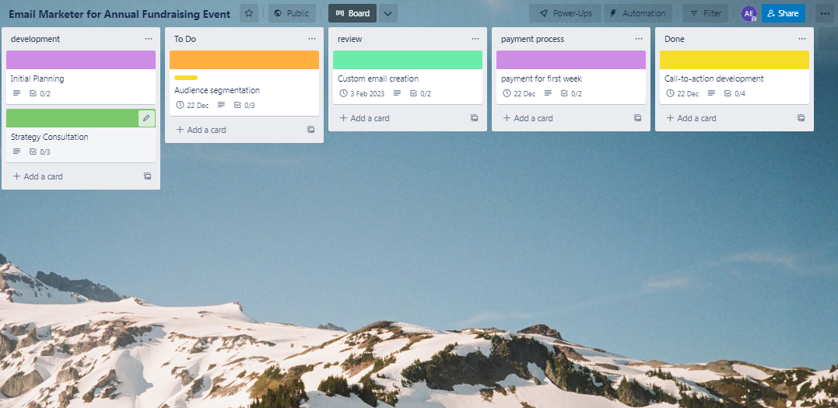
Trello Board
Please include the following information for your Trello board:
A link to your public Trello board should be provided here:
https://trello.com/b/WZV7ZyC5/email-marketer-for-annual-fundraising-event
Include a screenshot of the board below:
Paste screenshot here

Slide 11
Part 4
Invoice and Payment Options

Slide 12
Ahmed Elshety 921 LINCOLN BLVD SANTA MONICA CA 90403-2835 USA
Invoice
Recipient:
Taylor
2800 POE LN BRENTWOOD CA 94513-3908 USA
Invoice #: 9113500144782
Date issued: 01-12-2022
Date due: 25-12-2022
Services Rendered
Service | Description of Work Done | Hours Spent | Amount Per Hour | Total
audience segmentation | set correct the audience segmentation strategy | 3 | 30$ | 90$
custom email creation | Make video call, chat, send calendar invites. | 2 | 35$ | 70$
plan | Make a correct plan for managing the project | 5 | 40$ | 200$
create tasks | Create tasks for the whole project | 4 | 30$ | 120$

Slide 13
Ahmed Elshety
921 LINCOLN BLVD SANTA MONICA CA 90403-2835 USA
Invoice
Services Rendered (continued)
Service | Description of Work Done | Hours Spent | Amount Per Hour | Total
Doing the task | Start making the tasks of the project | 6 | 30$ | 180$
Review tasks | Review the tasks and test them after finishing. | 4 | 35 | 140$
Total Payment Due: 800$
Payment Options: A/C: 12AB-34CD Bank: U.S. Bancorp Visa : 367527376988357 PayPal : 55815

